Slide 1

ANTI-RAGGING WEB PORTAL

Slide 2
By
(MOHD SHAJEB FARUQUI , AJAY PATWAL , KYNJRI BAJWAT , PRIYANKA RAJPUT , SANJAY KUMAR GUPTA)
BTECH IV Year
Computer Science Engineering
RollNo.1621610065 , 1621610011 , 1621631019)
Under the Supervision of Faculty Name(Debashish Barua)
Department of Computer Science Engineering
College Name : IIMT College of Engineering
Abdul Kalam Technical University , Lucknow

Slide 3
Project Name : ANTIRAGGING PORTAL
Submitter Name : MOHD SHAJEB FARUQUI , AJAY PATWAL , KYNJRI BAJWAT , PRIYANKA RAJPUT , SANJAY KUMAR GUPTA
Date Submitted :27/09/2019

Slide 4
TABLE OF CONTENTS
1 introduction
2 project And Product Overview
3 Scope
4 Duration
5 project understanding approval

Slide 5
introduction
Ragging has ruined countless innocent lives and careers. In order to eradicate it, Hon’ble Supreme Court in Civil Appeal No. 887 of 2009, passed the judgement wherein guidelines were issued for setting up of a Central Crisis Hotline and Anti-Ragging database. In accordance with the orders, UGC (University Grants Commission), Govt. of India has developed this web portal.
This portal will contain 1. Undertaking confirmed by each student and his/her parents or guardians, which will then be stored electronically and will contain the details of each student. 2. Record of registered complaints received and the status of the action taken.

Slide 6
Purpose of Project
The aim of the portal is to eliminate ragging in all its forms from universities, deemed universities and other higher educational institutions in the country. This will be achieved by preventing its occurrence and punishing those who indulge in ragging, in accordance with the Supreme Court Regulations.

Slide 7
project And Product Overview
Anti-Ragging Portal is a online web applications by which students can register over there to make complain about ragging.
There is also a registration process for faculty who can check the coming request of students.
And there is a administrator over there who is responsible for maintaining overall system.
Anti-Ragging Portal can be divided into three modules , namely

Slide 8
Module 1: Administrator
This module is responsible for maintaining the overall system and it perform the following functions:
1. It can delete user.
2. It can modify the user details.
3. It can update website details.
Module 2: STUDENT
There is a registration form for students where they can file their complain after registering form on Web Portal.
Module 3: Faculty
There is also a registration process for Faculty once they got registered on Web Portal they will get the Login ID & Password. So they login their Portal and check the pending & live request of students.

Slide 9
Scope Objectives
The new user must register with the portal before availing any services from it.
For each registration maintain the record in the database for the new user.
For each new registration a profile is to be created if it is for the student as well as for the Faculty.

Slide 10
Duration Timeline
Project Plan Completed
Developed Prototype
System Development Completed
Requirements Analysis Completed
20/07/2019
22/07/2019
27/07/2019
01/08/2019

Slide 11
project understanding approval
The undersigned acknowledge they have reviewed the Project Understanding Document for the Anti-Ragging Portal project. Changes to this document will be coordinated with and approved by the undersigned or their designated representatives
Name : AJAY PATWAL Date : 01/08/2019
Role : Backend Developer

Slide 12
Name : MOHD SHAJEB Date : 01/08/2019
Role : Web Design
Name : SANJAY KUMAR Date : 01/08/2019
Role : SRS Documentation
Name : KYNJRI BAJWAT Date : 01/08/2019
Role : Frontend & Backend
Developer
Name : PRIYANKA RAJPUT Date : 01/08/2019
Role : SRS Documentation &
PPT

Slide 13
Anti-Ragging WEB Portal
Module | Use Case | Start Date | End Date
Admin | View , Update , delete | 27/07/2019 | 31/07/2019
Faculty | Register , login , logout , Replying to the complain | 22/07/2019 | 30/07/2019
Student | Register , login , logout , File a complain | 21/07/2019 | 23/07/2019

Slide 14
Operating Environment
Technologies to be used
Programming languages:
JAVA EE: Java Enterprise Edition is a programming platform— part of the Java Platform-for developing and running distributed multi-tier architecture Java applications, based largely on modular software components running on an application server.
HTML: Hyper Text Markup is the predominant markup language for web pages. It provides a means to describe the structure of text-based information in a document and to supplement that text with interactive forms, embedded images, and other objects.
JavaScript: A client side scripting language used to create dynamic web content and user interface.

Slide 15
Cascading Style Sheets (CSS) : It is a style sheet language used for describing the presentation of a document written in a markup language like HTML.^{[1]} CSS is a cornerstone technology of the World Wide Web, alongside HTML and JavaScript
Bootstrap : It is a free and open-source CSS framework directed at responsive, mobile-first front-end web development. It contains CSS- and (optionally) JavaScript-based design templates for typography, forms, buttons, navigation and other interface components

Slide 16
Tools & Development Environment:
Apache Tomcat 8.0.9 Server: Apache Tomcat is a Servlet container developed by the Apache Software Foundation (ASF). Tomcat implements the Java Servlet and the JavaServer Pages (JSP) specifications from Sun Microsystems, and provides a "pure Java" HTTP web server environment for Java code to run.
Eclipse : It is an integrated development environment (IDE) used in computer programming. Eclipse software development kit (SDK) is free and open-source software, released under the terms of the Eclipse Public License, although it is incompatible with the GNU General Public License.

Slide 17
External Interface Requirements
User Interfaces
The user interface is screen shown on the browser. The Home screen of the Web-Portal is where Faculty, students can register and login. The portal screen acts as an interface.
Hardware Interfaces
A minimum of 40GB of HDD, with Pentium IV processor, a minimum of 256MB of RAM so that a suitable OS (Windows XP ) may be installed, and a reliable internet connection is required for the client side/user side so that may be accessed easily.

Slide 18
Software Interface
The system uses:
JSP: Java Server Pages. It is a technology that helps software developers serve dynamically generated web pages based on HTML, XML and other document types; uses java programming language.
Servlet: Java web-containers which holds actions to be performed; a Servlet a java programming language class used to extend the capabilities of servers that host applications access via a request response programming model.
Struts: Java Framework to be used to develop web applications,
NetBeans6.9.1,Oracle 10g.
Oracle 10g: It is a object-Relational Database Management System. The Oracle DBMS can store and execute stored procedures and functions within itself.

Slide 19
Database Design Specification
Introduction
The ER Diagram of the assigned project Anti-Ragging Portal has three major entities namely: Administrator, Student and Faculty. These entities have their respective attributes enlisted with them.

Slide 20
Entity Relationship Diagram
Nationality
Admin_ID
Gender
Name
MobNo
name
EmailId
Course Name
ADMIN
City
Year of Study
pass
Student
Password
Manages
UserName
RollNo
UG_OR_PG
Username
State
Address2
Address1
Password
Faculty
Name
EmailID
Gender
Department
MobileNo

Slide 21
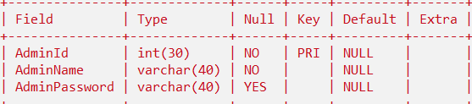
Tables
1. Admin

Slide 22
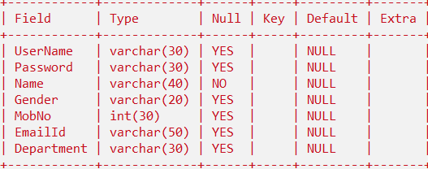
2. Faculty

Slide 23
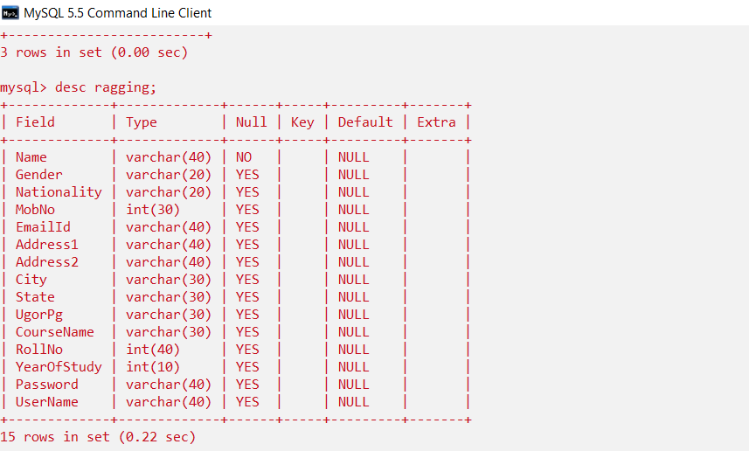
3. Student

Slide 24

ANTI-RAGGING WEB PORTAL
Submitted by
MOHD SHAJEB FARUQUI - 1621610065
AJAY PATWAL - 1621610011 KYNJRI BAJWAT -
SANJAY KUMAR GUPTA - PRIYANKA RAJPUT -
IIMT College of Engineering

